Slide 1
Career Planning Workshop
2025 UPB Romania

Slide 2
Hi, I’m Marian Banica
I’m passionate about Future-Proof Technology, i have 10+ years of experience in tech industry.
Milestones:
SAP Consultant
Microsoft Dynamics CE Senior Consultant
Product Manager
Business Solution Manager
Chief Digital Officer

Slide 3
Skills & expertise
Business Analysis
Software development
Requirements analysis
Budgeting
Managing teams of up to 12 people

Slide 4
Definitions
Career - A career can be defined as the sequence of employment-related experiences, roles, positions, and activities undertaken by an individual throughout their lifetime.
VUCA stands for Volatility, Uncertainty, Complexity, and Ambiguity. It's a concept that has been adopted in business and leadership contexts to describe environments or situations that are characterized by rapid and unpredictable changes, high levels of uncertainty, intricate interdependencies, and a lack of clarity or consensus.
A plan is a detailed proposal or method for achieving a specific goal or objective. It outlines the sequence of actions, resources needed, timelines, and responsibilities required to accomplish the desired outcome.

Slide 5
Career Planning
18-29 years old
The plan. Version 1.x
45+ years old
Version 3.x
30+ years old
Version 2.x
55-65 years old
Version 4.x

Slide 6



Version 1.0
What i like?
What is my educational background?
What are my skills?
What i am CERTIFIED to do?

Slide 7
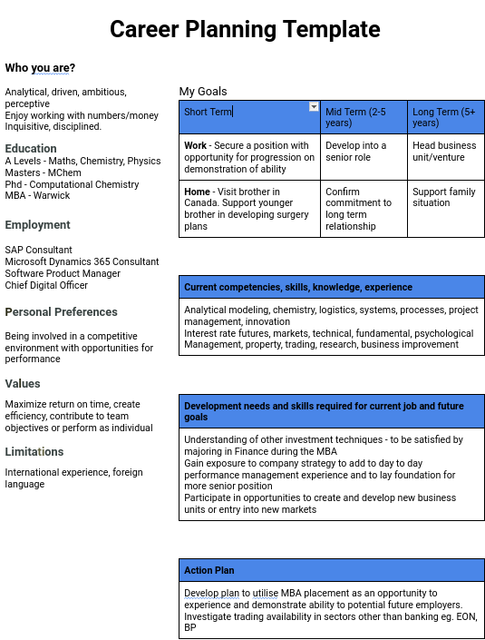
Version 1.0
What i like?
What is my educational background?
What are my skills?
What i am CERTIFIED to do?

Slide 8
Let’s see some examples *
From the other point of view

Slide 9
Practical advice(s)
Ask someone that is at your N+1 version of his/her plan
Invest all the time in education. Keep up your certification plan.
Languages
One foreign language is not enough (english in particular)

Slide 10

Q&A
Tech Trends
Low-Code development
AI prompting
Robotics & Automation

